Slide 1
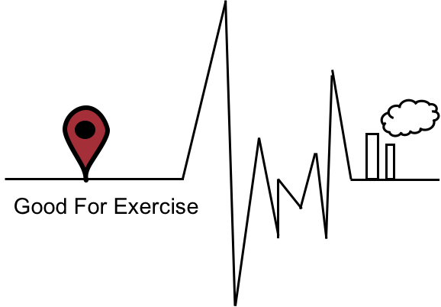

好運氣
TEAM：
SooChow University BigData Department

Slide 2
CONTENTS
Introduction
Future development
Team intro……………………P4
Motivation attributed….P5
Timeline………………………P6
Application……………….P16
Website
LOGO………………………..…P7
Website……………………….P8
2

Slide 3
INTRODUCTION
3

Slide 4




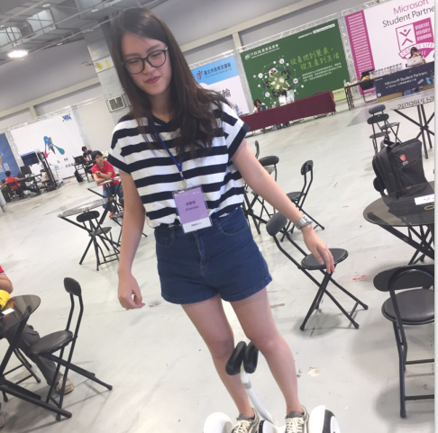

Team Intro
Angus Huang
Jenny Yang
Sophie Liu
Lily Li
Liz Li
4

Slide 5
Timeline
各類運動消耗熱量表
2012-2016 air quality
Data collecting
Presentation
website
Setting subject
Operation&revise
5

Slide 6
Motivation attributed
exercise
air quality
Recently,
more and more people go to exercise for their health and body shape.
Air quality is different between each city.
The citizens may want to know the information of it but they don't know how to get it.
Therefore, by the yearly information of air quality and the normal please that people go exercise. We will analyze what kind of exercise is proper enough to fix the air quality there. So that we will not do harm to our body instead because of the bad air quality.
6

Slide 7
WEBSITE
7

Slide 8
MEANING OF LOGO
WEBSITE
LOGO
AIR
QUALITY
HEALTH
SLOGAN
Link:https://fuminghuang.github.io/asian_gfe/
8

Slide 9
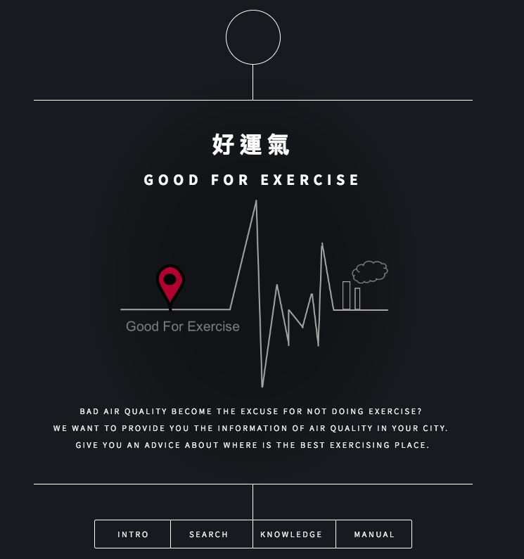
HOME PAGE
WEBSITE
NAME
WEBSITE
LOGO
CONTENTS
WEBPAGES
9

Slide 10
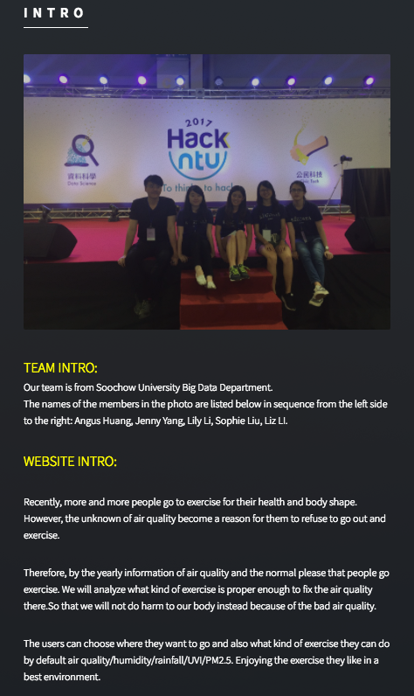
INTRO PAGE
TEAM’S
PHOTO
TEAM
INTRO
WEBSITE
INTRO
10

Slide 11
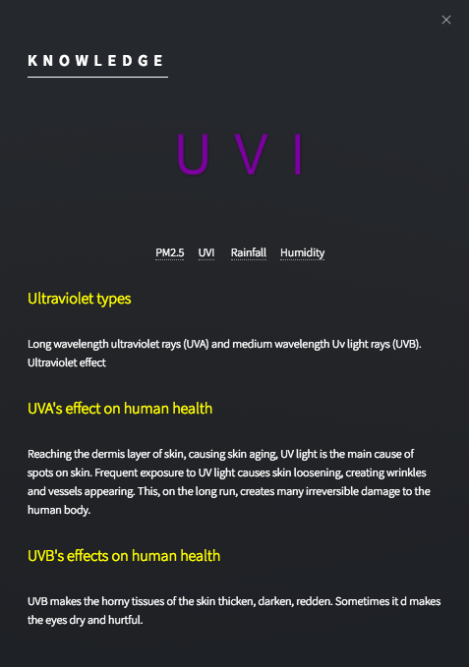
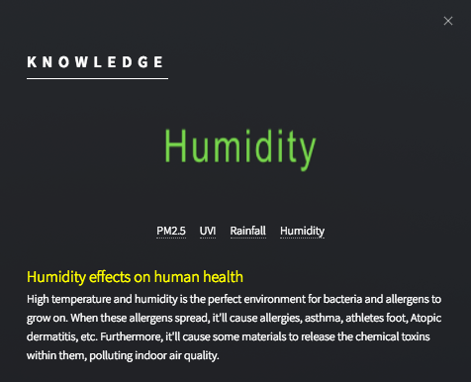
KNOWLEDGE PAGE – UVI & HUMIDITY
CONTENTS
11

Slide 12
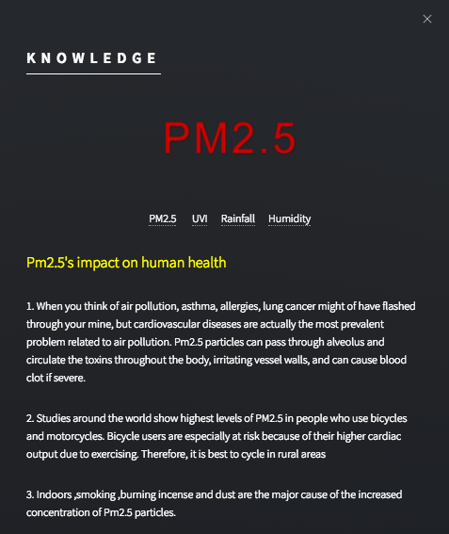
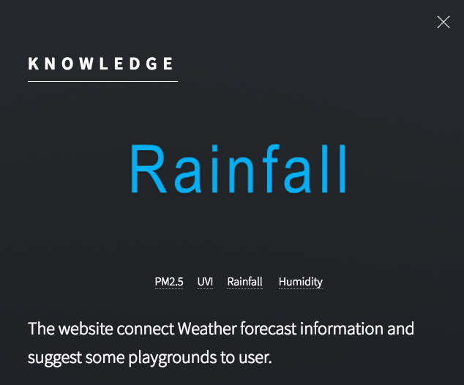
KNOWLEDGE PAGE – PM2.5 &RAINFALL
Contents
12

Slide 13
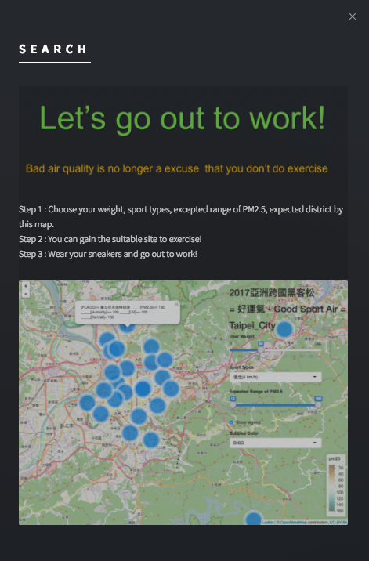
SEARCH PAGE
SLOGAN
STEP
MAP
13

Slide 14
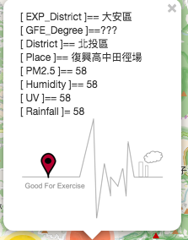
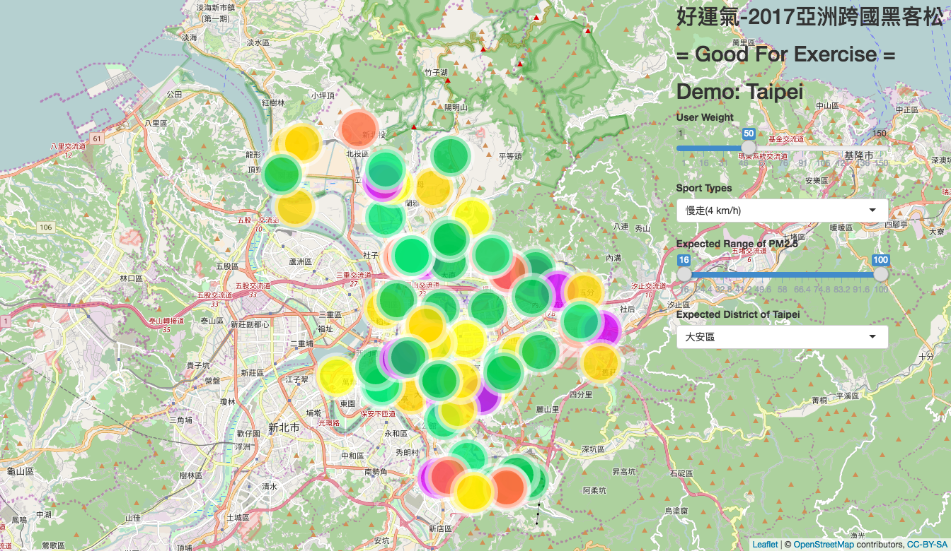
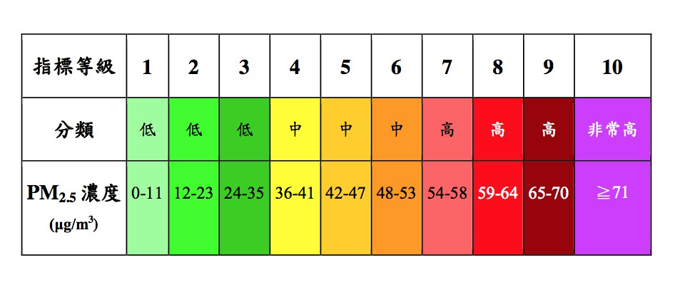
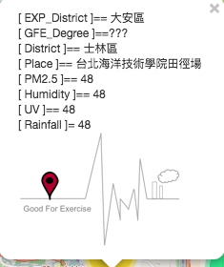
Map – good for exercise
level
sort
low
medium
high
PM2.5
Link: https://fmhuang.shinyapps.io/ProjectAsianHackthon/
14

Slide 15
Feature development
15

Slide 16
Application
預測路線
預測人數
First,
Plan the best routine to let users arrive the playground fast.
Second,
Using the information of air quality, construction, traffic accident to anlayze the most suitable routine to exercise.
Users choose the place, type of sports in the website , and we can get the data from this thing.
Therefore, we can predict how many people in the place, and people can avoid the rush hour.
16

Slide 17
Application
Traffic accident&construction
Indoors air quality
Recently, more and more people ride bikes/go road running. When you go out to exercise, you may get held up in a traffic accident/ construction.
First, we want to use the yearly information of traffic accident, and remind users which place has the most traffic accident.
Second, we want to send the real-time which place has construction, and let users to provide to go there for exercising.
Equipment,crowds,etc may let indoors air quality no safe for our health.
Therefore, we hope government can provide the information about monitoring indoors air quality.
Then, we can let the website has not only outdoors places, but also indoors ones.
17

Slide 18
THANK YOU!

